Slide 1
Extracting Pages of Booklet from 3D Volume Data through Solving Laplace Equation
Supervisor: KOYAMADA Koji
Project Leader: HAN Zhongjiang
Speaker: OU Jiarui

Slide 2
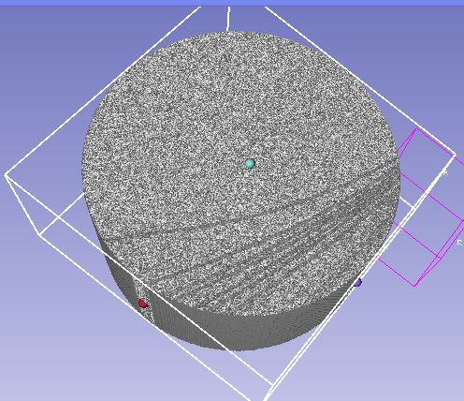
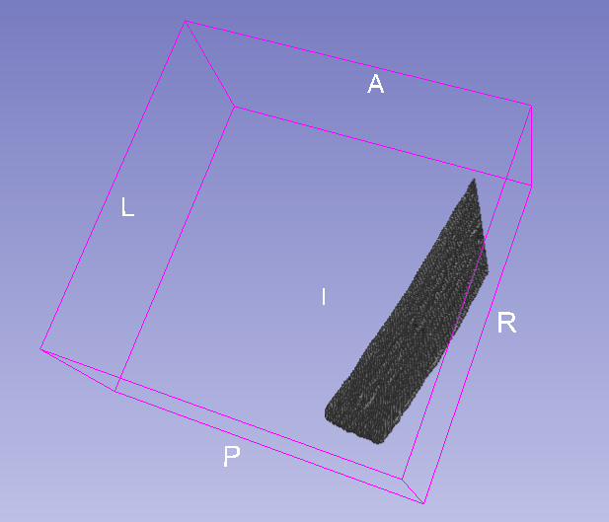
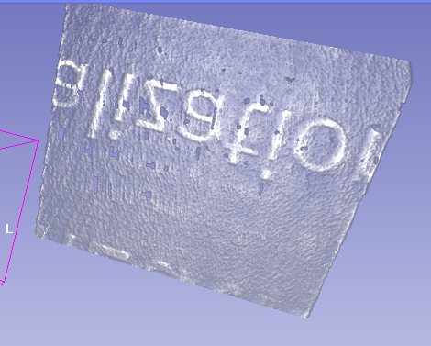
Research Background
After scanning the booklet in the CT machine, we could get the volume data with the single value about the gray value.
The information of the booklet is contained within these data. Thus, the requirement comes that the partial data standing for pages need to be extracted for further exploring about the information on those.

Slide 3
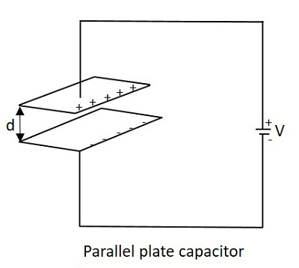

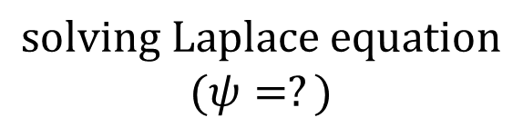
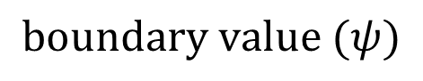
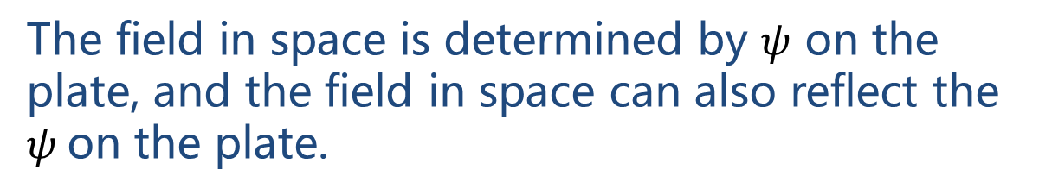
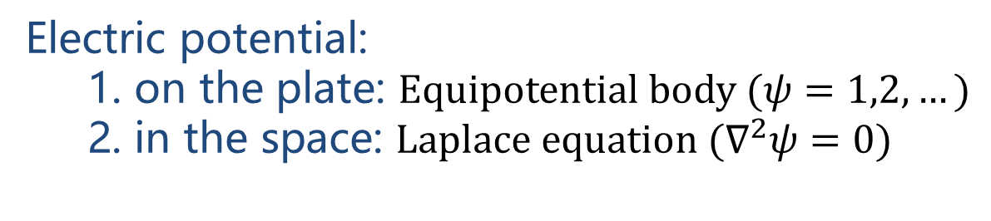
Model from Capacitors
Electric potential:
1. on the plate: $Equipotential body (ψ=1,2,…)$
2. in the space: $Laplace equation ({\text{∇}}^{2}ψ=0)$
The field in space is determined by $ψ$ on the plate, and the field in space can also reflect the $ψ$on the plate.
Sampling →
(points on plates)
Field in space
→Whole pages?
$$solving Laplace equation$$
$$(ψ=?)$$
$$boundary value (ψ)$$

Slide 4
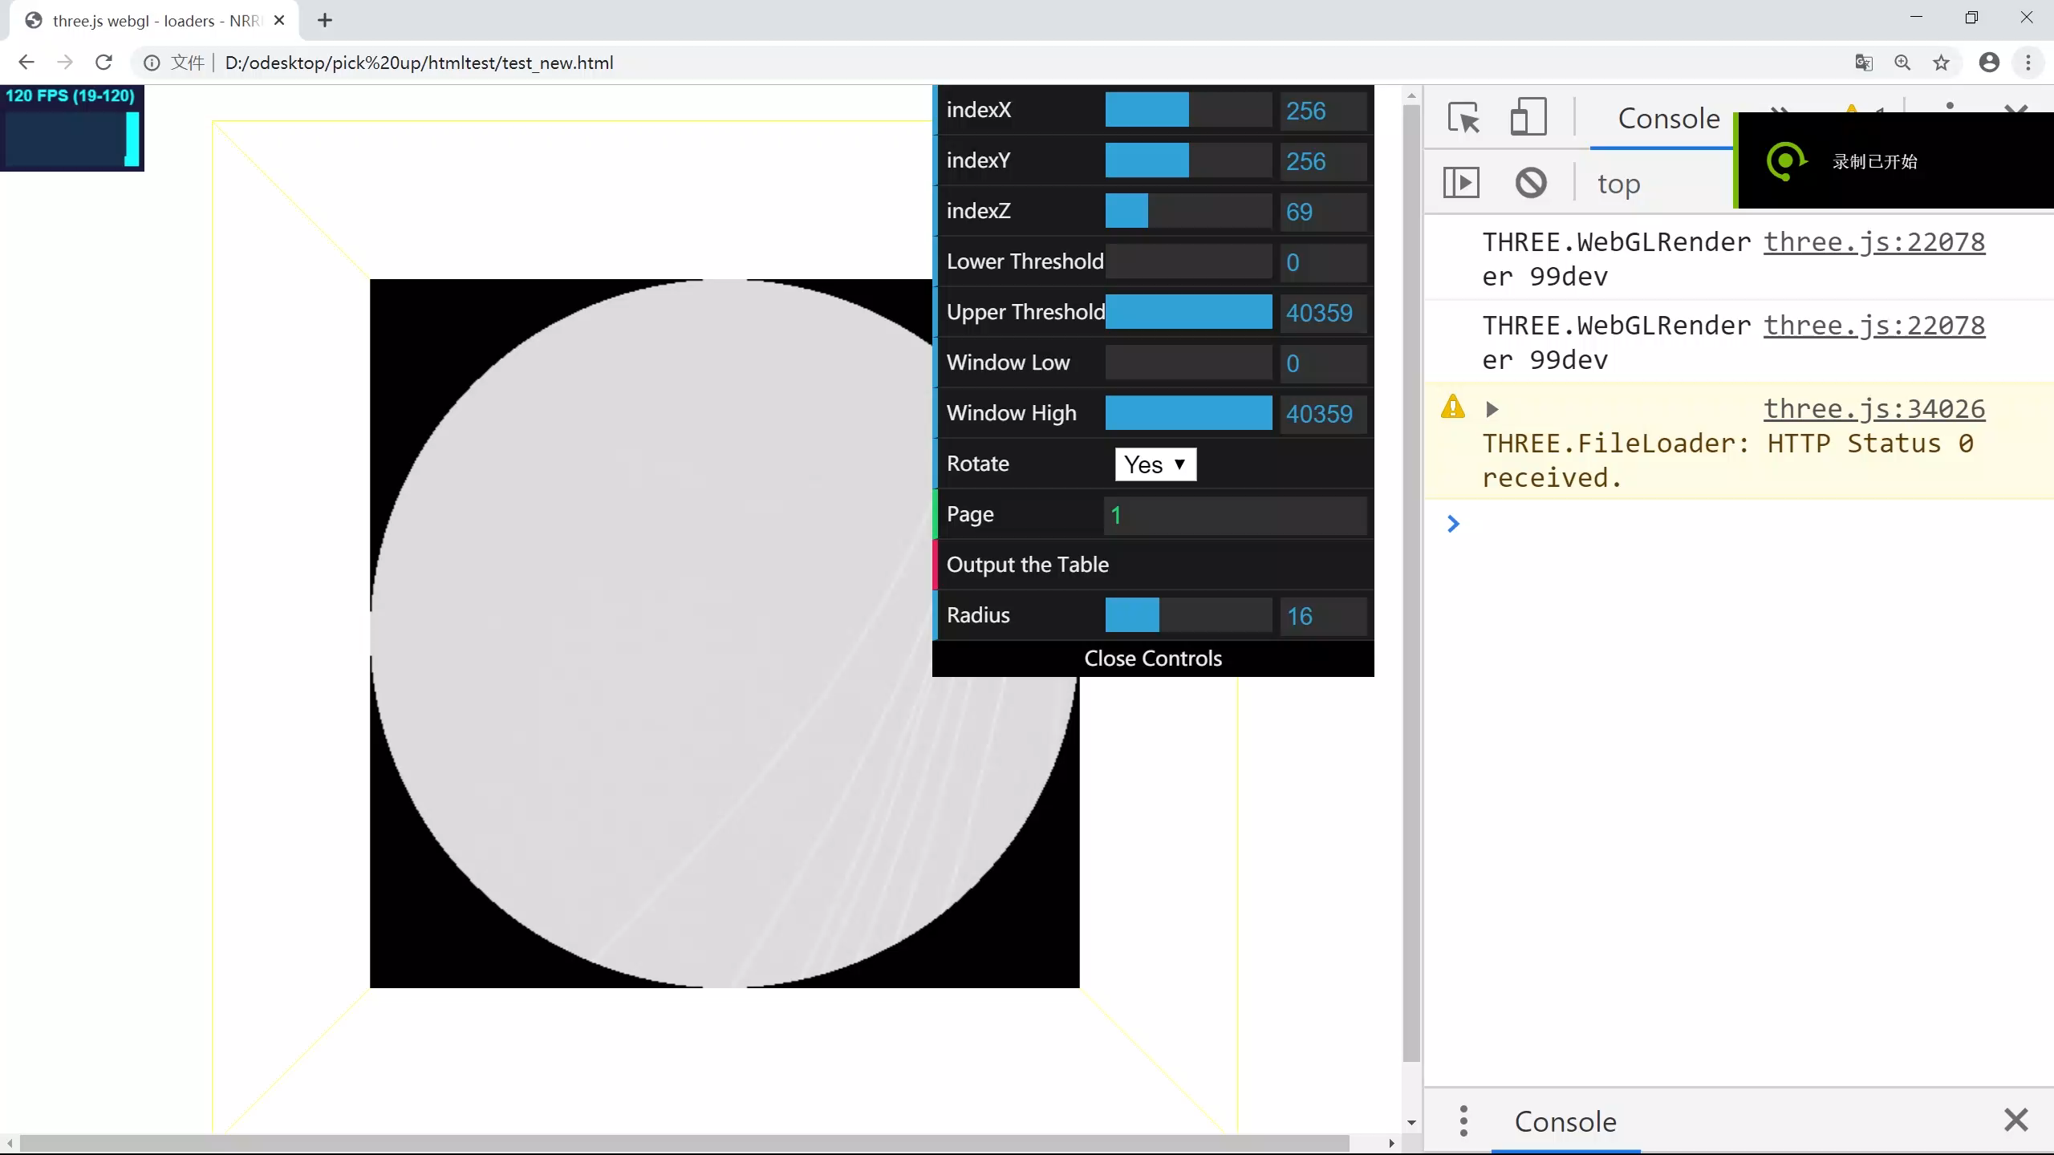
Sampling (Interaction GUI)

Slide 5
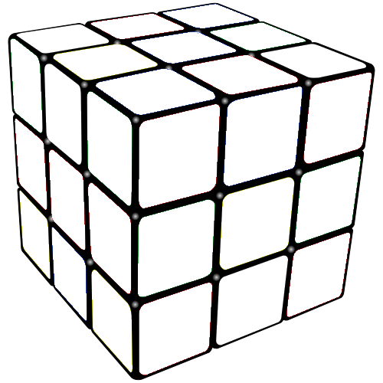
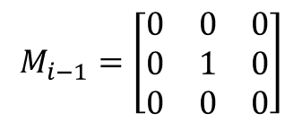



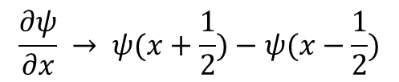










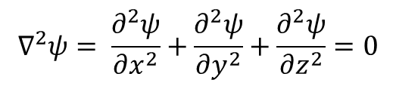
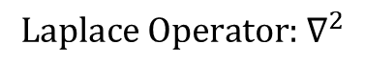




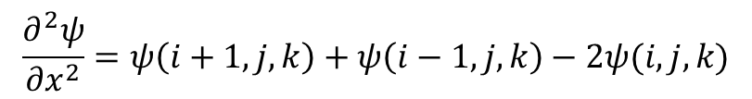




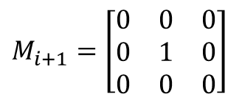


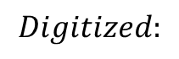
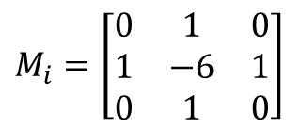





Knowledge about L.E.
$${\text{∇}}^{2}ψ= \frac{∂^{2}ψ}{{∂x}^{2}}+\frac{∂^{2}ψ}{{∂y}^{2}}+\frac{∂^{2}ψ}{{∂z}^{2}}=0$$
$$Digitized:$$
$$\frac{∂ψ}{∂x} → ψ(x+\frac{1}{2})−ψ(x−\frac{1}{2})$$
$$\frac{∂^{2}ψ}{{∂x}^{2}}=ψ\left(i+1,j,k\right)+ψ\left(i−1,j,k\right)−2ψ(i,j,k)$$
$${\text{∇}}^{2}ψ=ψ(i+1,j,k)+ψ(i−1,j,k)+ψ \left(i,j+1,k\right)+ψ\left(i,j−1,k\right)+ψ \left(i,j,k+1\right)+ψ\left(i,j,k−1\right)−6ψ(i,j,k)=0$$
$$0$$
$$0$$
$$0$$
$$0$$
$${Laplace \text{Operator}\text{: }\text{∇}}^{2}$$
$$0$$
$$1$$
$$0$$
$$0$$
$$0$$
$$0$$
$$M_{i−1}=\left[\begin{matrix}0 & 0 & 0 \\ 0 & 1 & 0 \\ 0 & 0 & 0\end{matrix}\right]$$
$M_{i}=$ $\left[\begin{matrix}0 & 1 & 0 \\ 1 & −6 & 1 \\ 0 & 1 & 0\end{matrix}\right]$
$M_{i+1}=$ $\left[\begin{matrix}0 & 0 & 0 \\ 0 & 1 & 0 \\ 0 & 0 & 0\end{matrix}\right]$
$$0$$
$$0$$
$$0$$
$$0$$
$$0$$
$$0$$
$$1$$
$$0$$
$$0$$
$$0$$
$$0$$
$$1$$
$$0$$
$$0$$
$$0$$
$$0$$
$$0$$
$−$6

Slide 6
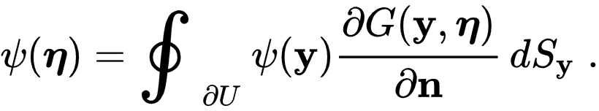
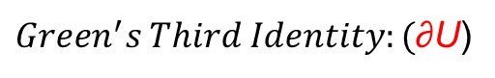
Solution 1
$${\text{∇}}^{2}ψ=ψ(i+1,j,k)+ψ(i−1,j,k)+ψ \left(i,j+1,k\right)+ψ\left(i,j−1,k\right)+ψ \left(i,j,k+1\right)+ψ\left(i,j,k−1\right)−6ψ(i,j,k)=0$$
$$ψ\left(i,j,k\right)=[ψ(i+1,j,k)+ψ(i−1,j,k)+ψ \left(i,j+1,k\right)+ψ\left(i,j−1,k\right)+ψ \left(i,j,k+1\right)+ψ\left(i,j,k−1\right)]/6$$
(start with on designed initial field)
Iteration (keep the sampled points value as constant)
one stable field (theoretically)
×(in practice)
$Green^{′}s Third Identity:($∂U)
Boundary converges quickly

Slide 7
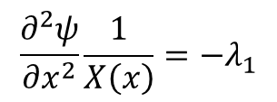
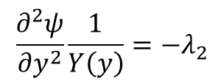
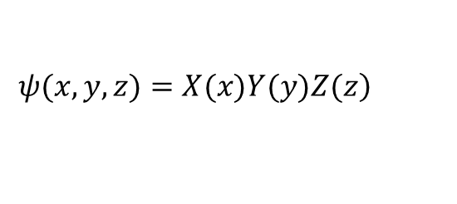
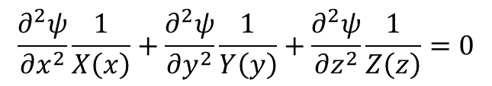
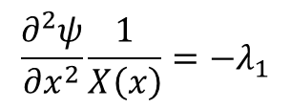
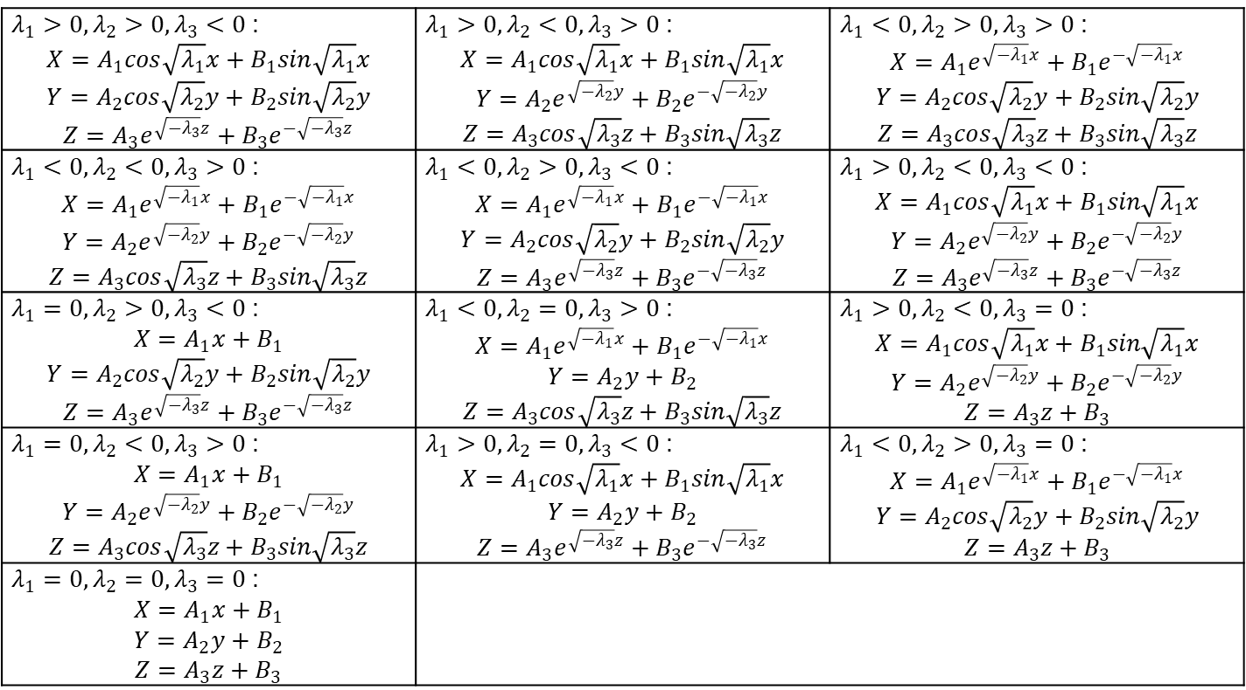
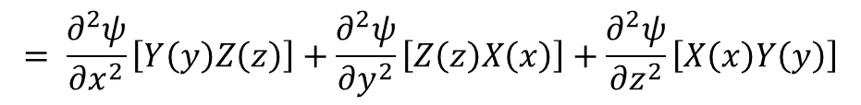
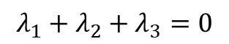
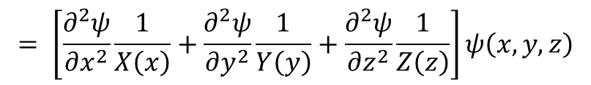
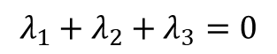
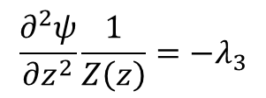
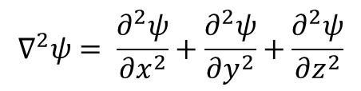
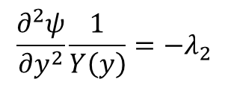
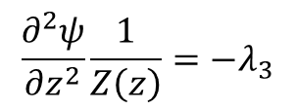
Solution 2
Rigorous solution:
$$\frac{∂^{2}ψ}{{∂x}^{2}}\frac{1}{X\left(x\right)}=−λ_{1}$$
$$\frac{∂^{2}ψ}{{∂y}^{2}}\frac{1}{Y\left(y\right)}=−λ_{2}$$
$$\frac{∂^{2}ψ}{{∂z}^{2}}\frac{1}{Z\left(z\right)}=−λ_{3}$$
$$λ_{1}+λ_{2}+λ_{3}=0$$
Separation of variables
$$\left.ψ(x,y,z)=X(x)Y(y)Z(z\right)$$
$λ_{1}>0, λ_{2}>0, λ_{3}<0$: $$X=A_{1}cos\sqrt{λ_{1}}x+B_{1}sin\sqrt{λ_{1}}x$$ $$Y=A_{2}cos\sqrt{λ_{2}}y+B_{2}sin\sqrt{λ_{2}}y$$ $$Z=A_{3}e^{\sqrt{{−λ}_{3}}z}+B_{3}e^{−\sqrt{−λ_{3}}z}$$ | $λ_{1}>0, λ_{2}<0, λ_{3}>0$: $$X=A_{1}cos\sqrt{λ_{1}}x+B_{1}sin\sqrt{λ_{1}}x$$ $$Y=A_{2}e^{\sqrt{{−λ}_{2}}y}+B_{2}e^{−\sqrt{−λ_{2}}y}$$ $$Z=A_{3}cos\sqrt{λ_{3}}z+B_{3}sin\sqrt{λ_{3}}z$$ | $λ_{1}<0, λ_{2}>0, λ_{3}>0$: $$X=A_{1}e^{\sqrt{{−λ}_{1}}x}+B_{1}e^{−\sqrt{−λ_{1}}x}$$ $$Y=A_{2}cos\sqrt{λ_{2}}y+B_{2}sin\sqrt{λ_{2}}y$$ $$Z=A_{3}cos\sqrt{λ_{3}}z+B_{3}sin\sqrt{λ_{3}}z$$
$λ_{1}<0, λ_{2}<0, λ_{3}>0$: $$X=A_{1}e^{\sqrt{{−λ}_{1}}x}+B_{1}e^{−\sqrt{−λ_{1}}x}$$ $$Y=A_{2}e^{\sqrt{{−λ}_{2}}y}+B_{2}e^{−\sqrt{−λ_{2}}y}$$ $$Z=A_{3}cos\sqrt{λ_{3}}z+B_{3}sin\sqrt{λ_{3}}z$$ | $λ_{1}<0, λ_{2}>0, λ_{3}<0$: $$X=A_{1}e^{\sqrt{{−λ}_{1}}x}+B_{1}e^{−\sqrt{−λ_{1}}x}$$ $$Y=A_{2}cos\sqrt{λ_{2}}y+B_{2}sin\sqrt{λ_{2}}y$$ $$Z=A_{3}e^{\sqrt{{−λ}_{3}}z}+B_{3}e^{−\sqrt{−λ_{3}}z}$$ | $λ_{1}>0, λ_{2}<0, λ_{3}<0$: $$X=A_{1}cos\sqrt{λ_{1}}x+B_{1}sin\sqrt{λ_{1}}x$$ $$Y=A_{2}e^{\sqrt{{−λ}_{2}}y}+B_{2}e^{−\sqrt{−λ_{2}}y}$$ $$Z=A_{3}e^{\sqrt{{−λ}_{3}}z}+B_{3}e^{−\sqrt{−λ_{3}}z}$$
$λ_{1}=0, λ_{2}>0, λ_{3}<0$: $$X=A_{1}x+B_{1}$$ $$Y=A_{2}cos\sqrt{λ_{2}}y+B_{2}sin\sqrt{λ_{2}}y$$ $$Z=A_{3}e^{\sqrt{{−λ}_{3}}z}+B_{3}e^{−\sqrt{−λ_{3}}z}$$ | $λ_{1}<0, λ_{2}=0, λ_{3}>0$: $$X=A_{1}e^{\sqrt{{−λ}_{1}}x}+B_{1}e^{−\sqrt{−λ_{1}}x}$$ $$Y=A_{2}y+B_{2}$$ $$Z=A_{3}cos\sqrt{λ_{3}}z+B_{3}sin\sqrt{λ_{3}}z$$ | $λ_{1}>0, λ_{2}<0, λ_{3}=0$: $$X=A_{1}cos\sqrt{λ_{1}}x+B_{1}sin\sqrt{λ_{1}}x$$ $$Y=A_{2}e^{\sqrt{{−λ}_{2}}y}+B_{2}e^{−\sqrt{−λ_{2}}y}$$ $$Z=A_{3}z+B_{3}$$
$λ_{1}=0, λ_{2}<0, λ_{3}>0$: $$X=A_{1}x+B_{1}$$ $$Y=A_{2}e^{\sqrt{{−λ}_{2}}y}+B_{2}e^{−\sqrt{−λ_{2}}y}$$ $$Z=A_{3}cos\sqrt{λ_{3}}z+B_{3}sin\sqrt{λ_{3}}z$$ | $λ_{1}>0, λ_{2}=0, λ_{3}<0$: $$X=A_{1}cos\sqrt{λ_{1}}x+B_{1}sin\sqrt{λ_{1}}x$$ $$Y=A_{2}y+B_{2}$$ $$Z=A_{3}e^{\sqrt{{−λ}_{3}}z}+B_{3}e^{−\sqrt{−λ_{3}}z}$$ | $λ_{1}<0, λ_{2}>0, λ_{3}=0$: $$X=A_{1}e^{\sqrt{{−λ}_{1}}x}+B_{1}e^{−\sqrt{−λ_{1}}x}$$ $$Y=A_{2}cos\sqrt{λ_{2}}y+B_{2}sin\sqrt{λ_{2}}y$$ $$Z=A_{3}z+B_{3}$$
$λ_{1}=0, λ_{2}=0, λ_{3}=0$: $$X=A_{1}x+B_{1}$$ $$Y=A_{2}y+B_{2}$$ $$Z=A_{3}z+B_{3}$$
$${\text{∇}}^{2}ψ= \frac{∂^{2}ψ}{{∂x}^{2}}+\frac{∂^{2}ψ}{{∂y}^{2}}+\frac{∂^{2}ψ}{{∂z}^{2}}$$
$$= \frac{∂^{2}ψ}{{∂x}^{2}}\left[Y\left(y\right)Z\left(z\right)\right]+\frac{∂^{2}ψ}{{∂y}^{2}}\left[Z\left(z\right)X\left(x\right)\right]+\frac{∂^{2}ψ}{{∂z}^{2}}\left[X\left(x\right)Y\left(y\right)\right]$$
$$= \left[\frac{∂^{2}ψ}{{∂x}^{2}}\frac{1}{X\left(x\right)}+\frac{∂^{2}ψ}{{∂y}^{2}}\frac{1}{Y\left(y\right)}+\frac{∂^{2}ψ}{{∂z}^{2}}\frac{1}{Z\left(z\right)}\right]ψ\left(x,y,z\right)$$
$$\frac{∂^{2}ψ}{{∂x}^{2}}\frac{1}{X\left(x\right)}=−λ_{1}$$
$$\frac{∂^{2}ψ}{{∂y}^{2}}\frac{1}{Y\left(y\right)}=−λ_{2}$$
$$\frac{∂^{2}ψ}{{∂x}^{2}}\frac{1}{X\left(x\right)}+\frac{∂^{2}ψ}{{∂y}^{2}}\frac{1}{Y\left(y\right)}+\frac{∂^{2}ψ}{{∂z}^{2}}\frac{1}{Z\left(z\right)}=0$$
$$\frac{∂^{2}ψ}{{∂z}^{2}}\frac{1}{Z\left(z\right)}=−λ_{3}$$
$$λ_{1}+λ_{2}+λ_{3}=0$$

Slide 8
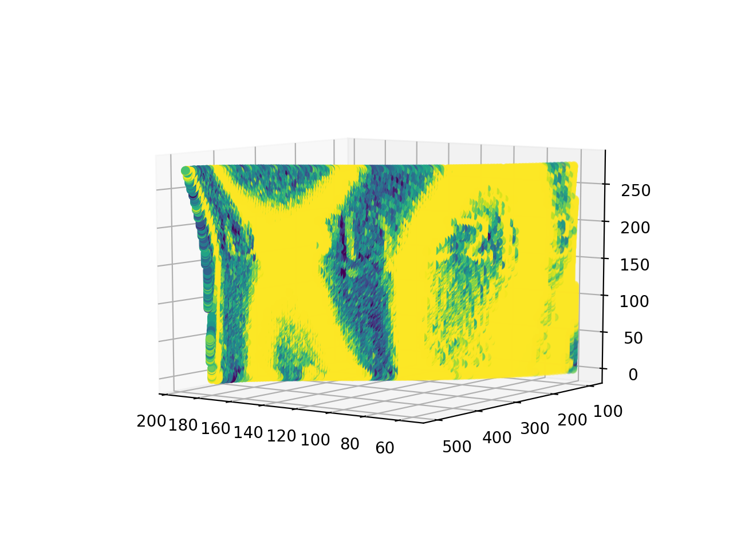
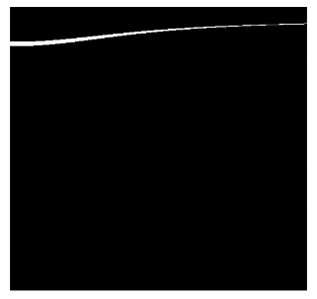
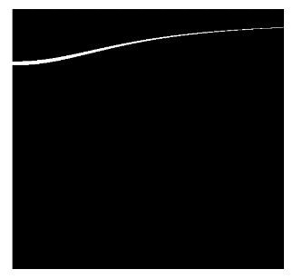
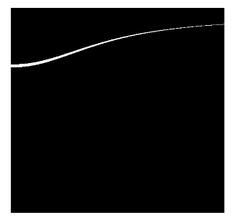
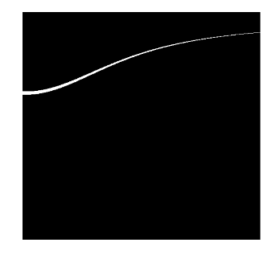
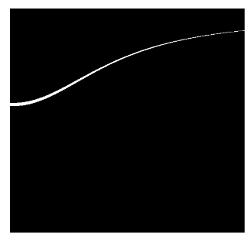
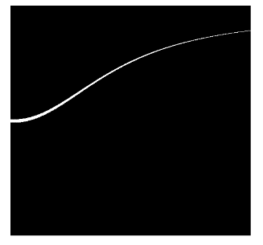
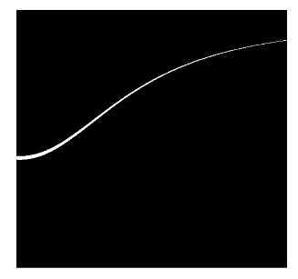
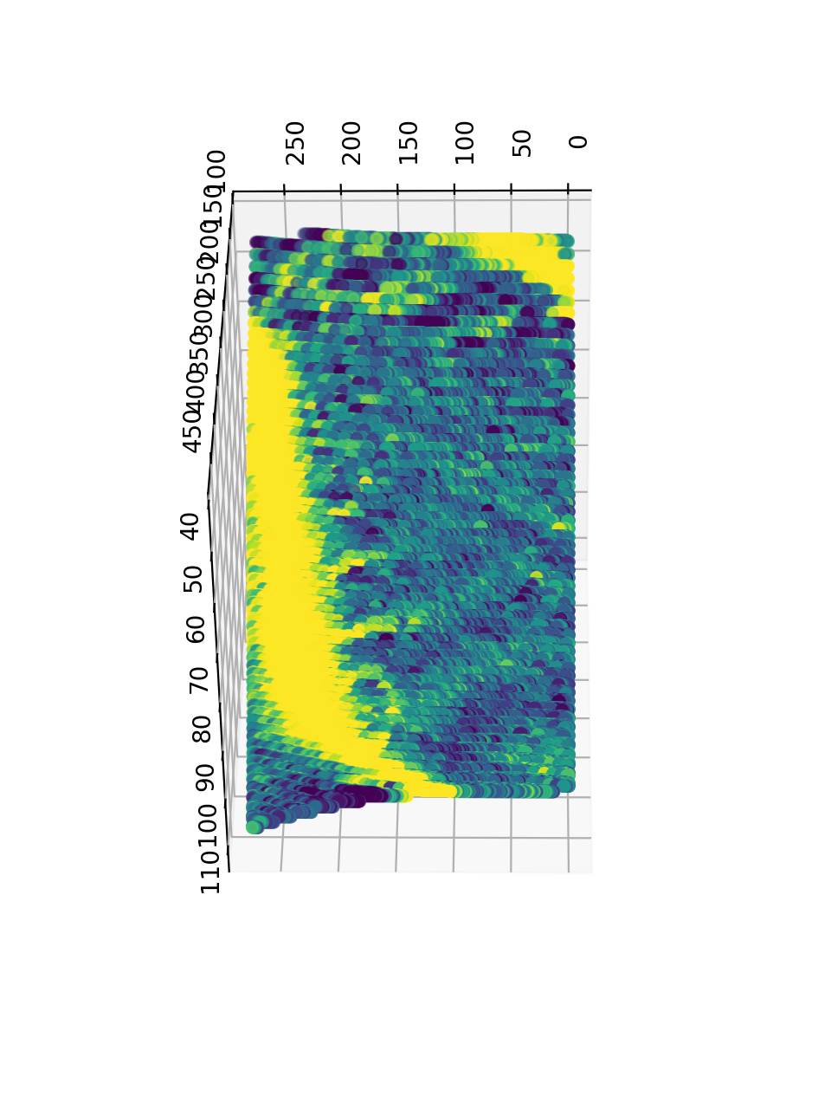
Solution 2
Linear partial differential equation
Solution: the linear combination of the basic solutions
$$ψ=\left(A_{1}e^{\sqrt{{−λ}_{1}}x}+B_{1}e^{−\sqrt{−λ_{1}}x}+C_{1}x+D_{1}\right)∗\left(A_{2}e^{\sqrt{{−λ}_{2}}y}+B_{2}e^{−\sqrt{−λ_{2}}y}+C_{2}y+D_{2}\right)∗(A_{3}cos\sqrt{λ_{3}}z+C_{3}z+D_{3})$$

Slide 9


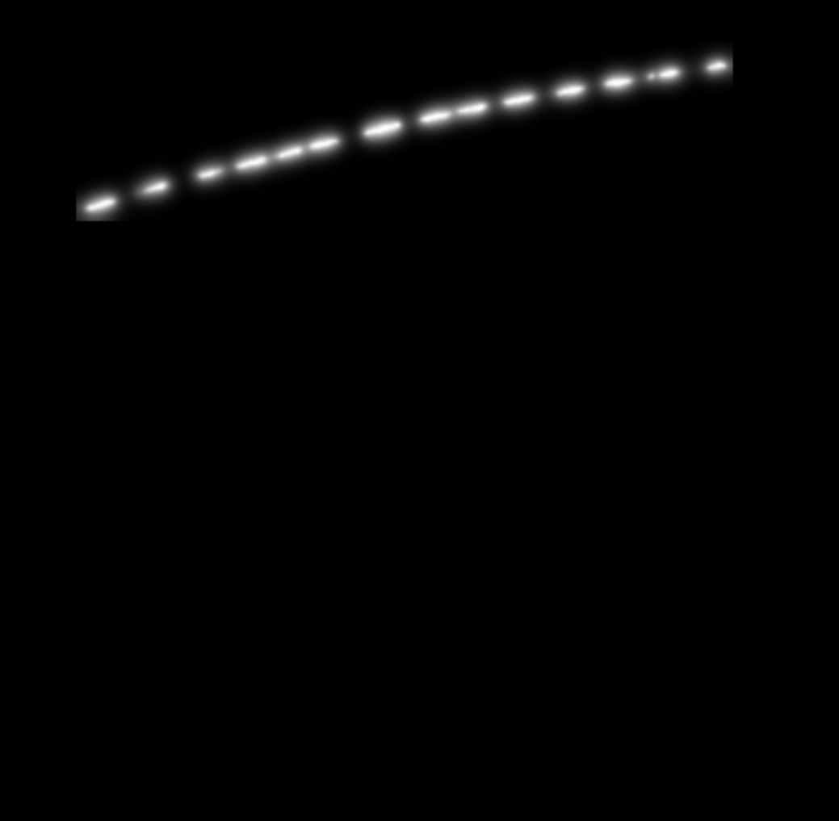
Solution 1 & 2
broaden the range
Solution 2
used as initial field
Solution 1

Slide 10
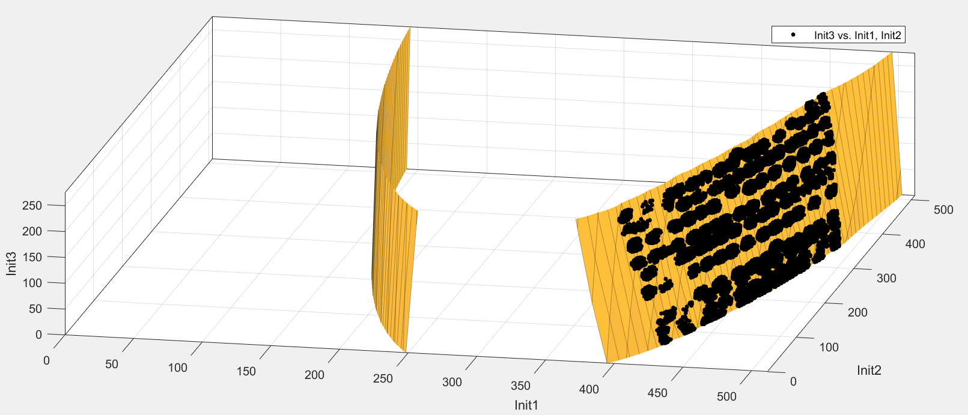
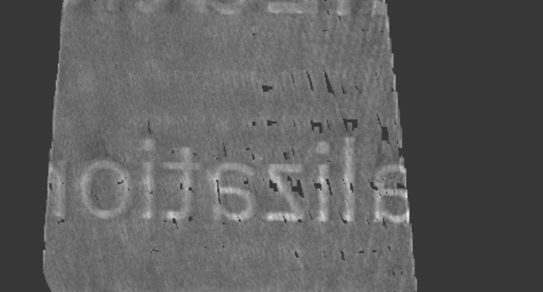
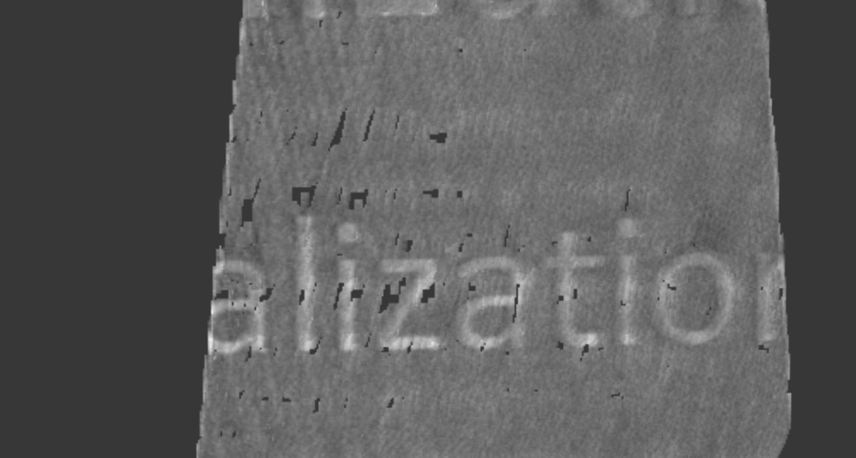
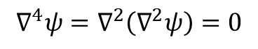
Solution 3
Biharmonic equation:
$${\text{∇}}^{4}ψ={\text{∇}}^{2}\left({\text{∇}}^{2}ψ\right)=0$$
R-Squared Definition: 0.9973
SSE(Sum of Squares for Error): 7.004*10^(5)

Slide 11
Thanks for your attention!

